Slide 1
UNIT II
TRAVEL AGENCY OPERATIONS
Topic:
Meaning
Concept
Definition
Types of Travel Agency

Slide 2
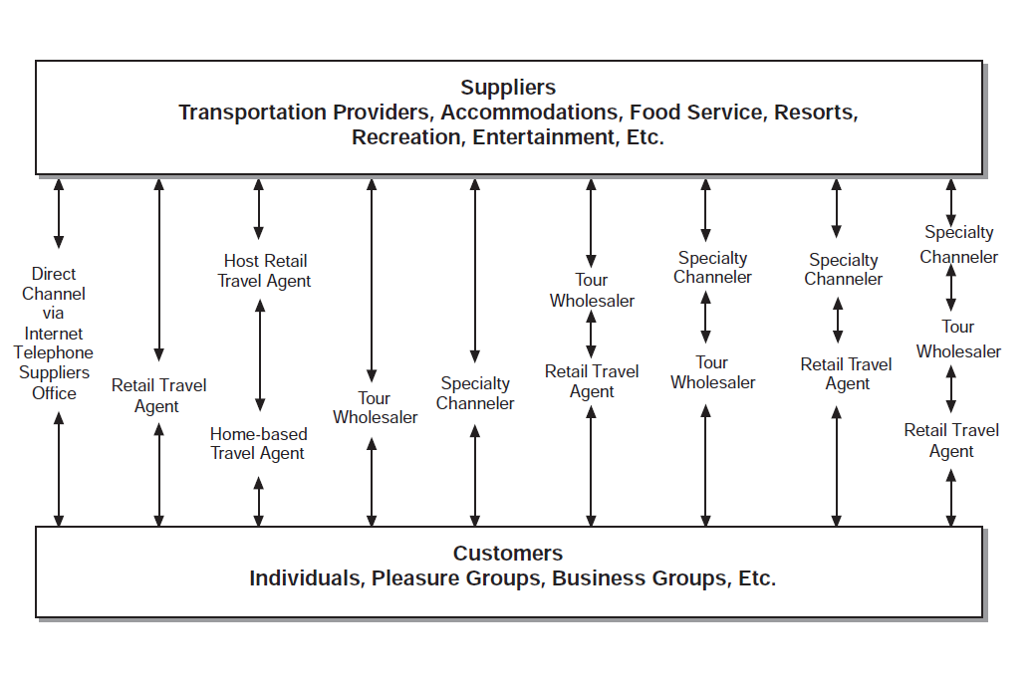
Travel distribution channels

Slide 3
Concept of Travel Agency
Travel, whether for business or pleasure, requires arrangements
Traveler have variety in choices regarding transportation and accommodation
For pleasure trip, variety of choice regarding destinations, attractions and activities.
The traveler may gather information on prices, value, schedules, characteristics of the destination, and available activities directly, investing a considerable amount of time on the Internet, or possibly money on long-distance telephone calls, to complete the trip arrangements.
Alternatively, the traveler may use the services of a retail travel agency, obtaining all these arrangements for a fee.

Slide 4
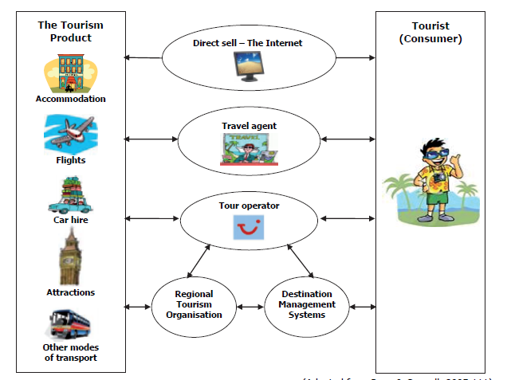

Slide 5
Meaning and definition of Travel Agency
A travel agency is a middleman—a business or person selling the travel industry’s individual parts or a combination of the parts to the consumer.
In marketing terms, a travel agent is an agent middleman, acting on behalf of the client, making arrangements with suppliers of travel (airlines, hotels, tour operators) and receiving a commission from the suppliers and/or a fee from the client.
A travel agent is thus an expert, knowledgeable in schedules, routing, lodging, currency, prices, regulations, destinations, and all other aspects of travel and travel opportunities.
In short, the travel agent is a specialist and counselor who saves the client both time and money.

Slide 6
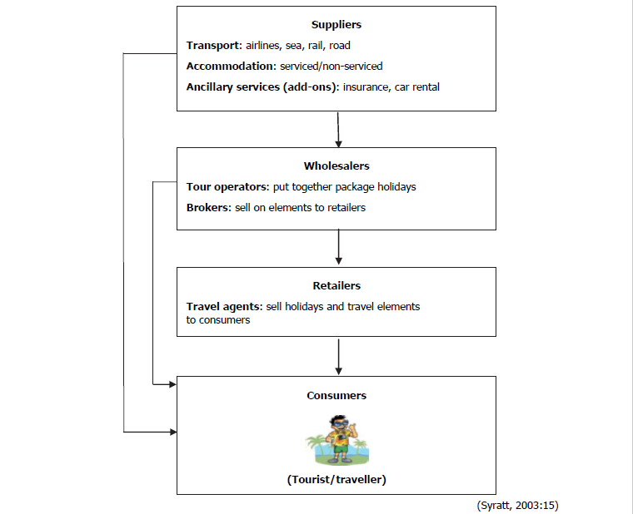

Slide 7
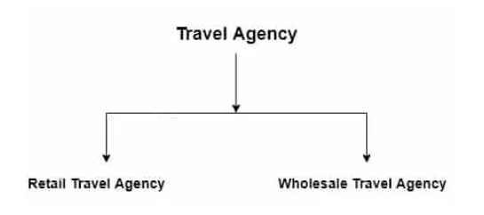
Types of travel agency

Slide 8
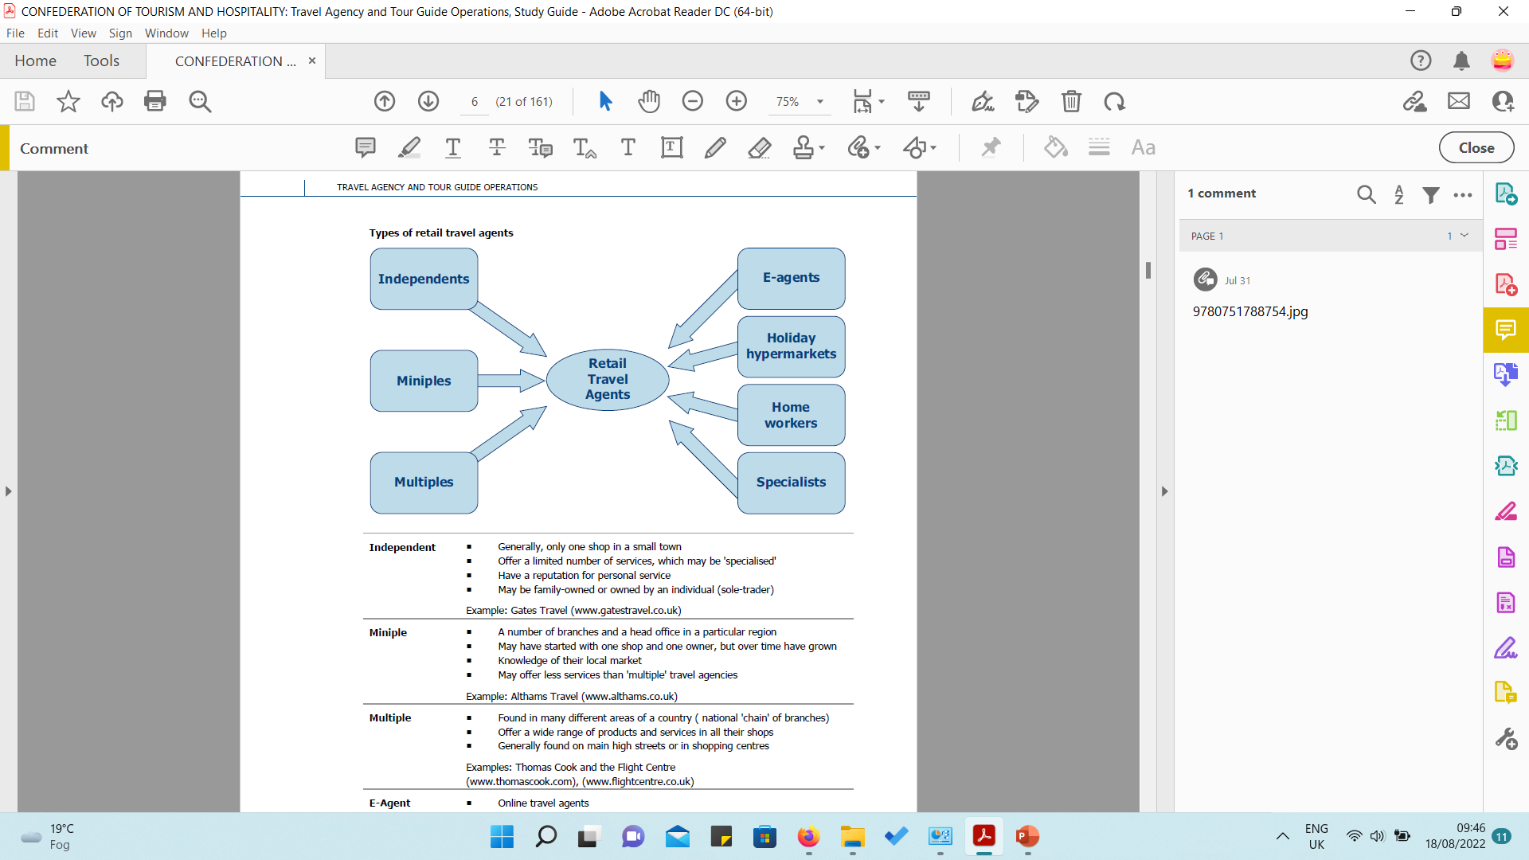
Independent: One shop in town
Miniple: Number of branches in a particular region
Multiple: Found in different areas of country
E-agent: Online travel agents, major tour operators
Holiday hypermarket: very large retail travel agencies, specialist staff in particular holiday types/
Homeworker:
Specialist:

Slide 9
Types of travel Agency
Retail travel agency:
Sells tourists products directly to the public on the behalf of the suppliers of the product and in return gets a commission
Packages sold on a commission basis and mark up the price.
Wholesale travel agency:
Purchases tourists’ product components in the bulk and designs tour packages.
Sometimes, a wholesale travel agency buys travel components from the vendor in bulk and resells them to other travel business originations.

